Slide 1
IBM Public Cloud

Slide 2

I
Client example of a workload transformation
Write and Develop Apps quickly on Kubernetes using Cloud Foundry
Migrate AIX Apps to POWER on IBM Cloud
IBM Cloud Paks for Red Hat OpenShift
1
2
3
4
5
6
Lift and shift VMware workloads to IBM Cloud
Develop and deploy cloud native apps at hyperscale with 190+ API driven interfaces
Containers and Red Hat OpenShift on IBM Cloud
IBM Cloud
2

Slide 3












IBM public cloud: Technology momentum and innovation
Reserved for Bare Metal and Cascade Lake Platform Introduction for Bare Metal | 6th MZR Launch in Sydney | Hyper Protect Crypto Services | Virtual Private Cloud
Power VMs-as-a-Service | World record performance benchmark for SAP | Cloud Paks on IBM Cloud | NextGen Hyperscaler VSIs
Templating with Content Catalog and Schematics | KYOK Service Adoption (VMware, COS, Block, VSI) | Red Hat OpenShift-as-a-service on the IBM Cloud | World’s first Financial Services-ready public cloud
IBM Cloud
3

Slide 4



IBM Cloud: The most open and secure public cloud for business
Highest level of Encryption
FIPS 140-2 Level 4
Isolation for Cloud Native
ROKS & Containers on BareMetal
Enhanced Availability SLAs
HA: 99.99%, Non-HA: 99.9%
Higher SLA payouts vs Market
25% of monthly @60 min
No Cost Bandwidth b/w Regions
Significantly lower TCO
Audit Transparency to Bare metal
Traceable Serial number compliance
Full Control to Bare metal level
Full admin control of compute
Open Innovation
Security Leadership
Enterprise Grade
API Services that are cloud delivered
Kubernetes on IBM Cloud: 1k+ clients, 19k+ clusters in production
Major contributor to cloud native open source work: Istio, Knative, Razee, etc.
Highest compliance for data encryption
Configurable so that even IBM cannot see your data
Edge-to-cloud threat management with IBM security integration
#1 VMware public cloud 2,000 clients
Cloud migration for Power AIX, IBM i, Z, SAP and mission critical
Broadest portfolio of compute instances, including Power & X86
World's First Financial Services-Ready Public Cloud With Bank of America
Good Design
Award for VPC
Good Design
Award for API Connect
Customer Choice Award for Cloud IaaS
Stratus Award for User Experience
IBM Cloud
4

Slide 5
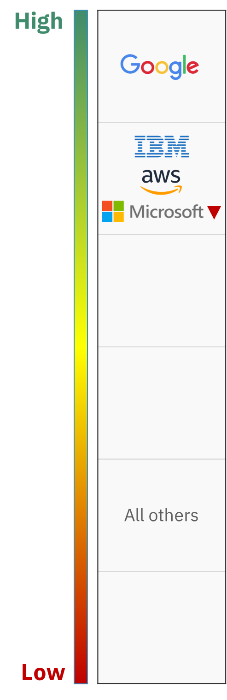




External NPS benchmarks are positive for IBM Cloud Platform
Competitive NPS - Cloud Platform
IBM Cloud is used for more complex tasks
Surveys in 1H & 2H 2019
% of complex tasks (more than half of tasks are considered advanced)
IBM and competitors are serving users doing very different “jobs” or tasks.
IBM serves significantly more clients focused on complex tasks
This is an advantage for IBM as 47% of customers rate their public & private cloud environments as 'very complex’ per IDC
Statistically-significant change since previous wave
Competitor cracks are emerging
Microsoft and AWS ratings were low in:
ease of set up
ease of use
help easily accessible
support and docs helpful
IBM Cloud

Slide 6

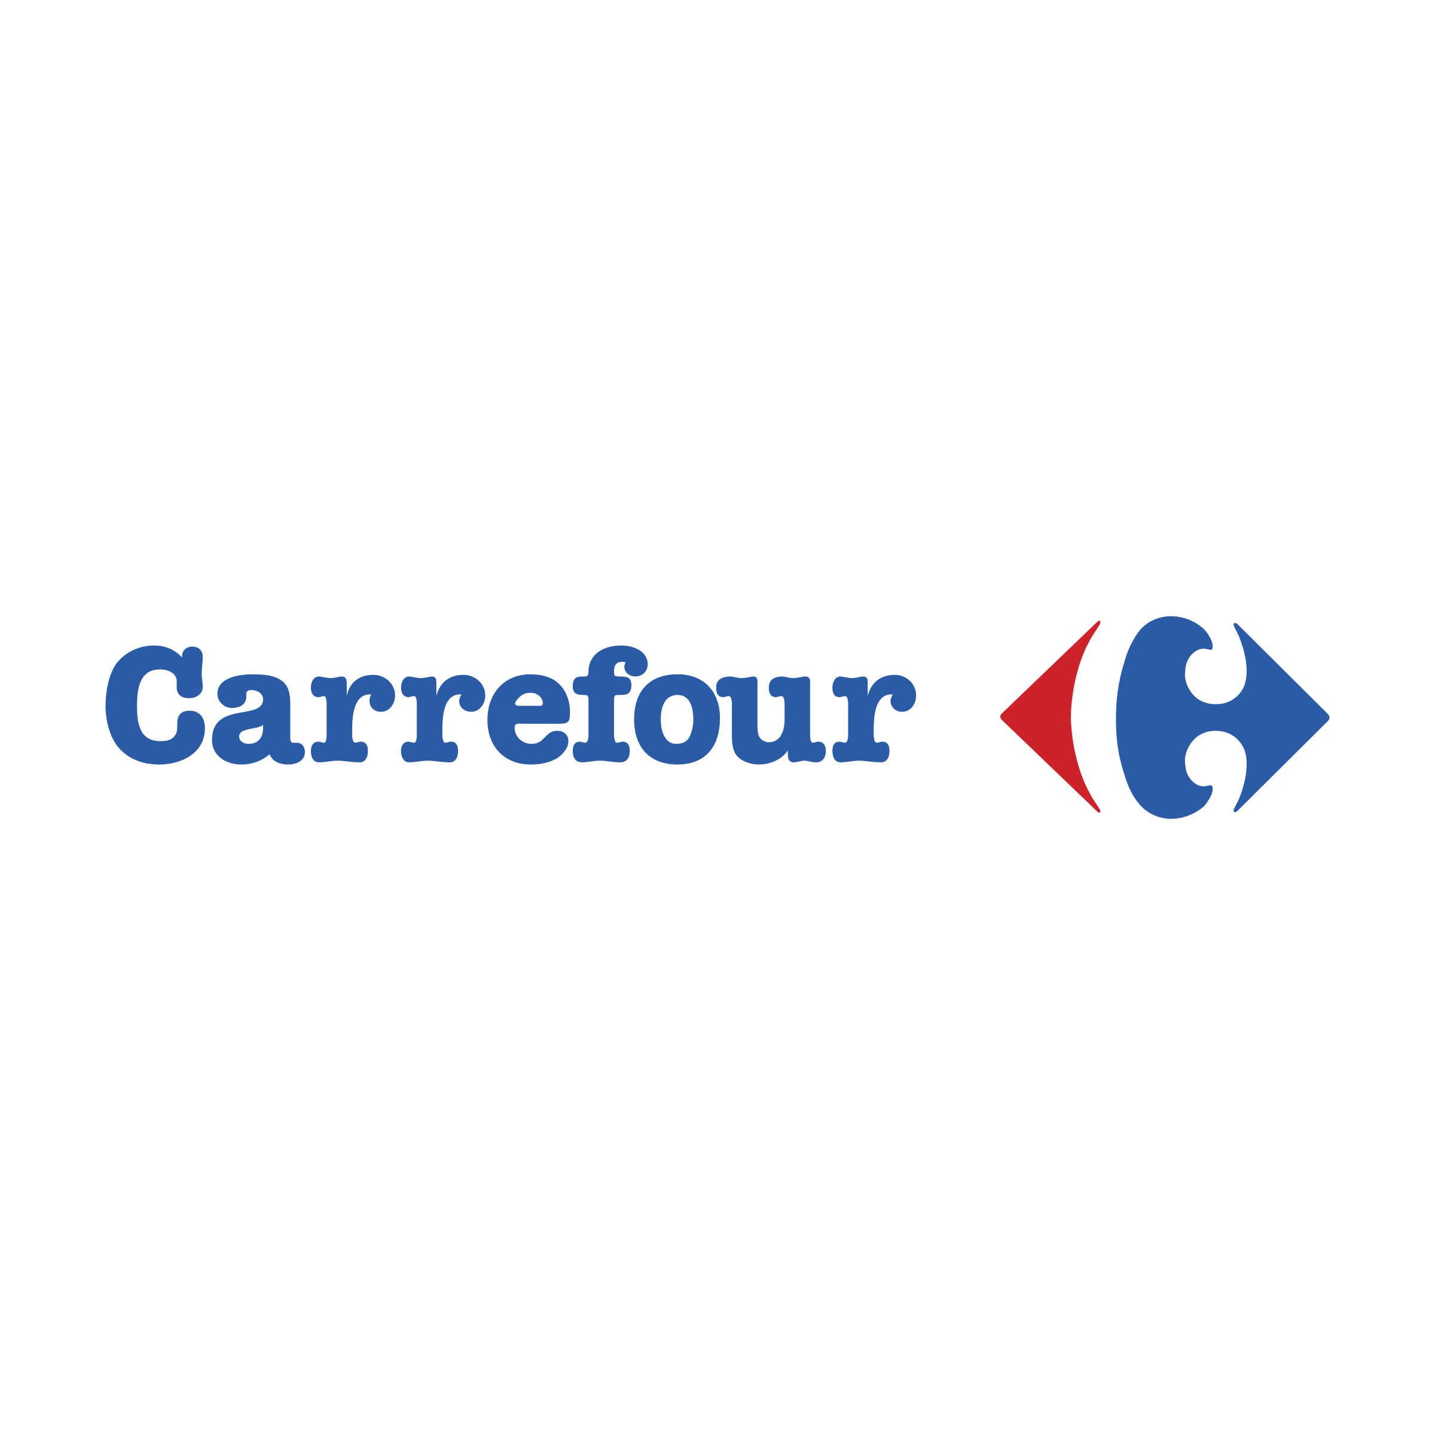
IBM public cloud performance and client experience
network
change
control system
architecture
Roadmap & Stability Focus
Availability Exceeded 99.95%
Customer Impacting Events and Time to Resolution down
Client Conversation Shifted to Usability and Features
Flawless Client Experience During Holiday Season
Enhanced GTS Interlock
38x workload increase
Dirk John, CIO: “Operation was pretty stable during the Black Friday. Some competitors had problems and we could also (happily) cope with the additional workload”
Dimitris Bountolos, CDO: “Great achievement guys with two million visits/day you did it one more time.”
+1.5M orders on Black Friday
Jeff Gennette, Chairman/CEO: “cyber Monday was a record breaking day! And the systems held up! thanks for the diligence and support”
100% SLA achieved
Mauriclo Guida, IT Ops Manager: “I would like to thank you for the exceptional work you did on Black Friday !!! Please tell your teams !!
I am very proud to have this whole team at my side, composed of incredible and very dedicated people !!!”

Slide 7
IBM public cloud catalog – Accelerating your journey to cloud
AI
Analytics
Security & Identity
Dev Tools
VPC
Service Type
IBM Service Third Party Service
Watson Assistant
Watson Studio
Compare and Comply
Discovery
Knowledge Catalog
Knowledge Studio
Language Translator
Machine Learning
Natural Language Classifier
Natural Language Understanding
Personality Insights
Speech to Text
Text to Speech
Tone Analyzer
Visual Recognition
Voice Agent with Watson
Watson OpenScale
PowerAI
Analytics Engine
DB2 Warehouse on Cloud
IBM Cognos Dashboard
Master Data Management
SQL Query
Streaming Analytics
Weather Company Data
AccountScore
App ID
Certificate Manager
Cloud HSM
FortiGate Security Appliance
Hardware Firewall
Hardware Firewall (Dedicated)
Hyper Protect Crypto Services
Hyper Protect Virtual Servers
Internet Services
Key Protect
Security Advisor
SSL Certificates
Contrast Security
FusionAuth
Twilio Authy
Twilio Verify
Availability Monitoring
Continuous Delivery
DevOps Insights
Cloud Event Management
Globalization Pipeline
Monitoring
Schematics
Toolchain
IBM Cloud Activity Tracker with LogDNA
IBM Cloud Monitoring with Sysdlg
IBM Log Analysis with LogDNA
Pager Duty
Block Storage for VPC
Load Balancer for VPC
Virtual Private Cloud
Virtual Server for VPC
VPN for VPC
Web & Mobile
Web & App
IoT
Telstra Messaging API
Twilio Programmable SMS
Twilio Programmable Video
Twilio Programmable Voice
Apache Spark
Consult with IBM Garage
Information Server
Managed Financial Data API
Simulated Instruments Analytics API
Accern-API
Network ACL for VPC
Subnet for VPC
Alloy
Bondevalue-API
CloudAMQP
Difitek
Dwolla
ElephantSQL
Envestnet | Yodlee
FundingShield – Wire Accounts Verification Service (WAVS)
HazardHub Property Risk Data API
Health Score
Hydrogen
Morningstar
Natural Language Generation APIs
Payeezy
Plaid
Powerlytics Behavior/Propensity Model API
Powerlytics Consumer Income API
Powerlytics Investable Assets & Wealth API
Quovo
Rainbow
RelSci
Risk Engine
SizeUp Small Business Intelligence
Strands Business Financial Management
Totum Risk
TradeIt
uCloud Multitenant Core Platform for VMWare
WealthEngine API
Xignite Market Data APIs
Ylabs
IoT Platform
Weather Company Data
AT&T Flow Designer
AT&T IoT Data Plans
Bosch IoT Rollouts
Car Diagnostic API
Precision Location
Unification Engine
Mobile Foundation
Push Notifications
Email Delivery, powered by Sendgrid
Bitbar Testing Cloud
Esri ArcGIS for Developers
Nexmo
Phunware Location Based Services
Phunware Mobile Marketing Automation
SPLICE Pre-CAT Insurance Notifications
Starter Kits
Node.js Web App with Express.js
Python Microservice Flask
Python Web App with Django
Python Web App with Flask
Watson Assistant Basic
Watson Natural Language Understanding Basic
Watson Visual Recognition Basic
Node-RED Starter
Databases
Storage
Network
Integration
Custom Vision Model for Core ML with Watson
Internet of Things Platform Starter
Java Microservice with MicroProfile and Java EE
Java Microservice with Spring
Java Web App with Spring
Mobile Basic
Node.js Microservice with Express.js
Blockchain Platform
Cloudant
Databases for PostgreSQL
Databases for Redis
Databases for Elasticsearch
Databases for MongoDB
Messages for RabbitMQ
Databases for etcd
Compose Enterprise
Compose for RethinkDB
Db2
Db2 Hosted
Db2 Warehouse
Hyper Protect DBaaS for Mongo DB
Hyper Protect DBaaS for PostgreSQL
Informix
SQL Query
GEO Web Services
InfluxCloud
Block Storage
Block Storage for VPC
File Storage
IBM Cloud Backup
Object Storage
OSNEXUS Software Defined Storage for Bare Metal
Actifio GO
box
Load Balancers
Content Delivery Network
Direct Link Connect
Direct Link Dedicated
Direct Link Dedicated Hosting
Direct Link Exchange
Domain Name Service
FortiGate Security Appliance
Gateway Appliance
Internet Services
IPSec VPN
Load Balancer for VPC
Subnets/IPs
Virtual Private Cloud
VLAN
VPN for VPC
API Connect
APP Connect
Lift CLI
MQ
Secure Gateway
Rocket Mainframe Data
SPLICE PRE-Cat Insurance Notifications
Compute
Bare Metal Server
Cloud Foundry Enterprise Environment
HPCaaS from Rescale
Power System Virtual Server
Virtual Server
Virtual Server for VPC
WebSphere Application Sever
VMware vCenter Server on IBM Cloud
VMware vSphere on IBM Cloud NetApp ONTAP Select
Single-node Trial for Migration and App Modernization Single-node Trial for Data Protection & Disaster Recovery
Caveon RiskForesight on IBM Cloud
F5 on IBM Cloud
FortiGate Security Appliance on IBM Cloud
FortiGate Virtual Appliance on IBM Cloud
HCX on IBM Cloud
HyTrust CloudControl on IBM Cloud
HyTrust CloudControl on IBM Cloud
HyTrust DataControl on IBM Cloud
HyTrust KeyControl on IBM Cloud
IBM Cloud Private Hosted
IBM Cloud Secure Virtualization
IBM SPECTRUM Protect Plus on IBM Cloud
KMIP for VMware on IBM Cloud
Veeam Availability Suite for Virtual Server
Veeam on IBM Cloud
VMware vRealize Operations and vRealize Log Insight on IBM Cloud
Mission Critical VMWare on IBM Cloud
Managed Services from IMI
Managed Services for Veeam on IBM Cloud
Managed Services for Zerto on IBM Cloud
IBM Cloud Backup
OSNEXUS Software Defined Storage for Bare Metal
Plesk Onyx Linux Unlimited for Virtual Server
Red Hat Enterprise Linux OS for Virtual Server
Liberty for Java
SDK for Node.js
ASP.NET Core
Runtime for Swift
Go
PHP
Python
Ruby
Tomcat
Red Hat OpenShift Cluster
Kubernetes Service
Container Registry
Notes:
190+ services available now..

Slide 8

A large and growing
Market
Only 20% of enterprise workloads have moved to the cloud
From 27% to 34%
From 22% to 39%
Between 2019 and 2021, clients are migrating more – but inconsistently
Private
Clouds
Public Clouds
and SaaS
Dedicated
Clouds
On average, enterprises use 5 Clouds
Traditional Enterprise IT
From 39% to 16%
Source: 451 Research: Workloads & Key Projects Survey
Source: McKinsey, IT as a service: From build to consume
“2019 State of the cloud report.” RightScale. 2019.
8
© 2019 IBM Corporation
Notes:
Today’s reality is that clients are already in hybrid, multicloud environments. Even if they are modernizing in place or chipping away at challenges with individual public efforts, they are making efforts. They have data and apps on- and off-premise in public and private clouds, they use multiple vendors, and they are increasingly feeling challenged from their sometimes-hurried decisions. That’s part of the reason we still see that a small portion have moved to the cloud in any meaningful way.
According to 451 Research’s recent Voice of the Enterprise Digital Pulse: Workloads & Key Projects survey, over the next two years, enterprises are expected to expand their workload deployment on public cloud from 22 percent to 39 percent. However, private cloud is still the primary workload venue now, growing from 27 percent to 34 percent of workloads. Why? Most organizations, particularly large enterprises, don’t have the luxury of starting all over again on public cloud and therefore prefer to modernize mission-critical workloads in place. This may work for now, and in fact, we support a lot of this work when it is done right, but for some of our clients, this will be a temporary fix or band-aid approach and not a long-term strategy. Many of our clients are doing this because they need to use existing infrastructure investments, ensuring security and maintaining application and data dependencies.

Slide 9
IBM – Journey to Public Cloud
Journey to
Cloud
Advise on Cloud
Move to Cloud
Build for Cloud
Manage on Cloud
Life Cycle
Build
1
Advise on Cloud with IBM Garage ⎆ Helps to land with differentiated design and expand with 190+ public cloud & IBM Service offerings
Build for Cloud with Cloud Native ⎆ Build cloud native workloads with the most open, secure and enterprise ready cloud native platform
Build for Cloud with Cloud Paks ⎆ Accelerate modernization of workloads with Cloud Paks on Red Hat OpenShift on IBM Public Cloud
Move
Move to Cloud with VMware and SkyTap on IBM Public Cloud ⎆ Quickly migrate Vmware / SkyTap workloads and modernize with cloud native capabilities on Vmware / SkyTap
2
Move to Cloud with Power on IBM Public Cloud ⎆ Migrate and Extend IBM Power Enterprise Workloads (AIX, IBM i) to IBM Public Cloud
3
Manage
Manage on Cloud with Backup/DR for Business Continuity ⎆ Securely back up and restore your data
IBM Cloud
Seismic is the primary source of Enablement and Sales assets

Slide 10

IBM public cloud 1H 2020 sales promos
VMware
Cloud Paks
20 VMs free for 2 months and Expert services to move workloads
Clients running VMware on prem that want to leverage benefits of public cloud
For a client that buys a Cloud Pak, one instance on our IBM Cloud free for a year
IBM Middleware installed base clients and new clients
IBM Power Systems Virtual Server on IBM Cloud
RedHat OpenShift on IBM Cloud
$20K credits for 2 months and Expert services to move workloads
Power AIX and iSeries install base clients and Business Partners
For a client that wants to try RedHat OpenShift on IBM Cloud free for a year
All organizations looking to innovate on the cloud
IBM Cloud

